Slide 1
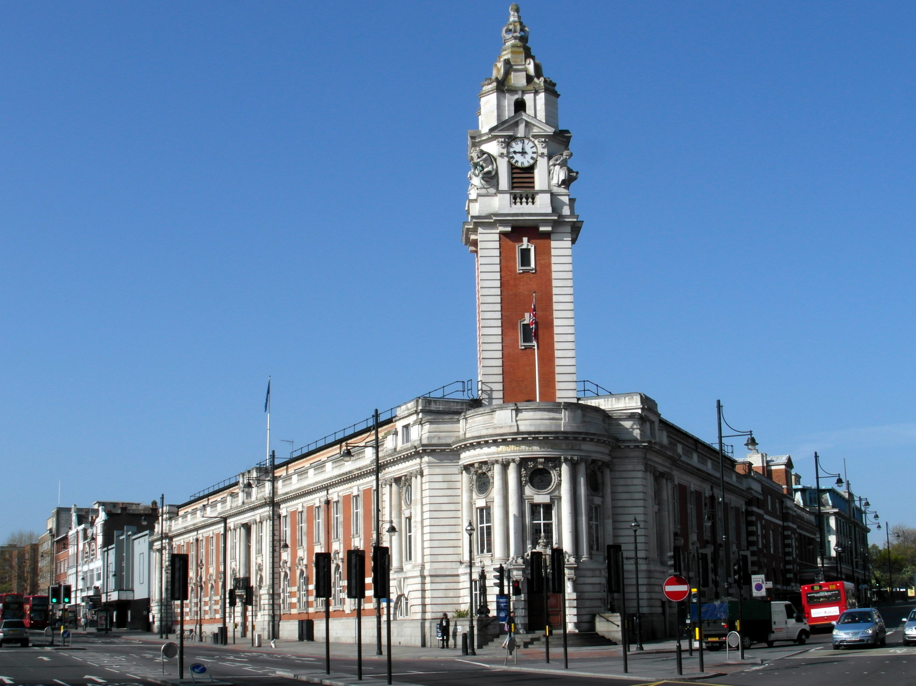

Annual Residents’ Survey 2023
Summary Report
July 2024
Research and Insight | Strategy and Communications
research@lambeth.gov.uk

Slide 2
Overview
Residents continue to report low levels of satisfaction.
Only 44% of all residents are satisfied with the way the Council runs things – below both the national and London benchmark. There has also been a significant decline in residents’ satisfaction with their local area – to 68%. More broadly, fewer residents feel safe during the day and at night, and more report having experienced sexual harassment or a hate crime in the last year. Across both social and private renters, satisfaction with landlords has also fallen.
However, encouragingly, the trend has stabilised for most other measures – putting the Council in a good position to pull resident satisfaction back up to its pre-pandemic levels. There may already be indications of this – with significantly more residents agreeing the Council provides value for money compared to this time last year. Further analysis of satisfaction also points to several areas where the Council can prioritise action and boost satisfaction over course of 2024 – from resident influence to child-friendliness.
Key challenges
Council satisfaction | This remains low although seems to have stabilised.
Area satisfaction | This has fallen significantly over the last year, including the extent to which residents feel they can go to their neighbours for advice.
Safety | Significantly fewer residents feel safe in their area during the day and at night. Experiences of sexual harassment and hate crime have also increased, with evidence of significant underreporting by victims.
Renting | Across both social and private renters, satisfaction with landlords and various aspects of renting has fallen significantly.
Key strengths
Value for money | Significantly more residents feel the Council provides value for money – bringing Lambeth up to the national benchmark.
Stability | Most measures have remained stable over the last year, in contrast to the prior more negative trend.
Resilience | Despite challenging circumstances and declines in some metrics, Lambeth residents are more likely than the average London resident to feel safe in and be satisfied with their local areas.

Slide 3








Annual Residents’ Survey 2023
Sample of
2,011 residents
Using Council Tax register, participants are
randomly selected by ward, proportional to the population of each ward
Fieldwork took place for ~5 weeks, from
23 Oct. – 30 Nov. 2023
Targets were set by ethnicity, age, gender, disability, and economic status to ensure a sample that is.
representative of Lambeth’s population
*Please note that while respondents were asked if they identified as Trans, there were not enough of those who did in the sample to pull out significant differences.
Survey interviews conducted
over the phone and online
While you’re reading, remember…
Red text and markers indicate results that are statistically significantly poorer than the comparator
Green text and markers indicate better results
Note on benchmarks
Where possible, many measures are compared to a national (LGA’s Oct. 2023 polling) and London (London Councils’ November 2023 Survey of Londoners ) benchmark. Consider these indicatively and with caution, as both sources utilised different methods.

Slide 4
Contents
Lambeth 2030 sets out key ambitions for our borough to achieve by 2030. To help us better understand how residents feel the borough is doing against these ambitions, we have grouped our ARS measures beneath them and used them to structure this report. In line with Lambeth’s Golden Thread – a Borough of Equity and Justice – we highlight significant inequalities and differences between communities in Lambeth throughout.
Council satisfaction
Overall satisfaction | 6-7
Value for money and communication | 8
Lambeth Council services | 9
Making Lambeth a place we can all call home
What needs to improve | 11
Influence and cohesion | 12
Living in the neighbourhood | 13
Growing up and aging well | 14
Financial situation | 15
Affording expenses | 16
Making Lambeth neighbourhoods fit for the future
Lambeth’s strengths | 18
Area satisfaction | 19-20
Town centres | 21
Housing and growth | 22
Overall health | 23
Mental health and wellbeing | 24
The environment and climate change | 25
Making Lambeth one of the safest boroughs in London
Feelings of safety | 27
Anti-social behaviours | 28
Harassment, hate crime, and confidence | 29
Recommendations and next steps
Key drivers for action | 31
Sample profile and demographics | 32

Slide 5

Council satisfaction

Slide 6

Overall satisfaction
Less than half of Lambeth residents are satisfied with how the Council runs things – continuing a sustained, low level of satisfaction seen since 2021.
Inter-group differences
Disabled residents (39%) vs non-disabled residents (46%)
Economically active (43%) vs economically inactive (51%)
Private renters (52%)
LGB (37%) vs heterosexual (46%)
44% are satisfied with how the Council runs things
Benchmark comparisons
vs London benchmark
50% satisfied
vs national benchmark
56% satisfied
-6
ARS
2021
QRS Q2
2022
QRS Q3
2021
QRS Q3
2022
ARS
2023
QRS Q1
2023
-12
QRS Q1
2022
QRS Q2
2023
QRS Q3
2023
ARS 2023
Q. Overall, how satisfied or dissatisfied are you with the way Lambeth Council runs things? Base: all respondents from group B, excluding don’t know (967).

Slide 7

Key drivers of Council satisfaction
The most important driver of satisfaction is whether residents feel they can influence decisions affecting their local area. People who agree they can influence decisions tend to be more satisfied with the Council, while those who disagree tend to be less satisfied. Its relative importance score (0.22) indicates that it over two times more important as a driver compared to, for example, whether residents find the Council easy to contact (ranked 6th,with a relative importance of 0.10).
Rank | Driver | Relative importance | Performance*
1 | Agree that they can influence decisions affecting local area | 0.22 | 24% net agree
2 | Council resolves things fully and gets things right first time | 0.18 | 30% net agree
3 | Rubbish or litter NOT a problem | 0.15 | 32% net not problem
4 | Feel informed by Lambeth Council about services | 0.14 | 41% net informed
5 | My town centre is welcoming | 0.13 | 44% net agree
6 | Lambeth Council is easy to contact | 0.10 | 42% net agree
7 | Have confidence in the police in local area | 0.09 | 35% net confidence
8 | Libraries - use regularly | 0.08 | 25% at least monthly
9 | Community and participation – best thing about local area | 0.07 | 11% best thing
10 | Agree local area is a place where older people can live well | 0.06 | 42% net agree
Key driver analysis is a statistical method that helps identify the factors that have the most impact on a particular outcome. In this case, we used it to understand what influences residents' satisfaction with the Council.
After analyzing other questions in the survey, we found that 10 particularly played a role, to varying degrees, in shaping residents' overall satisfaction this year. Together, these 10 questions account for 72.4% of the variation in residents' satisfaction with the Council.
*Figures do not exclude DK responses as done elsewhere, and so may differ slightly from figures in other slides in this report.

Slide 8


Value for money and communication
37% agree the Council provides value for money
Notable differences
Aged 65+ (49%)
Economically active (34%) vs inactive (47%)
Black residents (49%)
vs national benchmark
40% agree
-3
ARS
2021
ARS
2022
ARS
2023
40% feel the Council keeps residents informed
Notable differences
Female (38%) vs male (45%)
Vauxhall ward (14%)
vs national benchmark
56% agree
-16
ARS
2021
ARS
2022
ARS
2023
Q. To what extent do you agree or disagree that Lambeth Council provides value for money? Base: all respondents in group A excluding don’t know (1,019).
Q. How well do you think Lambeth Council keeps residents informed about the services and benefits it provides? Base: all respondents in group B excluding don’t know (944).

Slide 9








Lambeth Council services
Compared to 2022, residents’ perceptions of Lambeth’s services are mostly unchanged. This is a somewhat encouraging steadying of the trend, where last year’s ARS saw significant declines in satisfaction across almost all statements compared to 2021.
% great deal / some extent
(change from ARS 2022)
56% (-2)
55% (+1)
54% (-2)
52% (-2)
42% (+2)
32% (+0)
30% (-2)
Q. To what extent do you think that these statements apply to Lambeth Council? Base: all respondents (2,011).

Slide 10

Making Lambeth a place we can all call home

Slide 11




What needs to improve in Lambeth?
Clean streets continues to be the most commonly cited thing that needs improving in Lambeth, but the number of residents citing this has significantly decreased. There has also been a significant increase in residents raising concerns around low traffic zones and LTNs.
ARS 2022
Q. What are the three things that most need improving? Please choose up to three things Base: those in group A who identified an improvement (1,039)

Slide 12


Influence and cohesion
22% agree they influence decisions affecting their local area
Notable differences
Black residents (30%)
Economically active (20%) vs inactive (28%)
Owner-occupiers (17%) vs private renters (25%) and social renters (27%)
Residents with care experience (37%) vs residents without (21%)
Oval ward (35%) and Brixton Acre Lane ward (9%)
ARS
2021
ARS
2022
ARS
2023
81%
agree people from different backgrounds in their area get on well together
Notable differences
Female (84%) vs male (78%)
Council renters (70%)
Disabled (74%) vs non-disabled (83%)
Economically active (84%) vs inactive (76%)
Asian residents (71%)
Clapham Park ward (94%), Vauxhall ward (56%), and Clapham Common and Abbeville ward (62%)
North Lambeth town centre area (72%)
ARS
2021
ARS
2022
ARS
2023
Q. To what extent do you agree or disagree that you influence decisions affecting your local area? Base: all respondents in group B (972).
Q. To what extent do you agree or disagree that your local area is a place where people from different backgrounds get on well together? Base: all respondents in group B (972).
* NB | No recent benchmarks available for these questions.

Slide 13


Living in the neighbourhood
78%
agree they would be willing to work together with others on something to improve their neighbourhood
Notable differences
Residents aged 65+ (65%)
Owner-occupiers (80%) vs social renters (74%)
Residents in Waterloo town centre area (41%)
Residents who are satisfied with their local area (80%) vs residents who are dissatisfied (72%)
ARS
2021
ARS
2022
ARS
2023
39%
agree if they needed advice about something they could go to someone in their neighbourhood
Notable differences
Disabled residents (33%) vs non-disabled (42%)
Black residents (48%)
Renters (35%) vs owner-occupiers (43%)
Residents in Brixton Windrush ward (17%)
ARS
2021
ARS
2022
ARS
2023
* NB | No recent benchmarks available for these questions.
Q. Please say how strongly you agree or disagree... ‘I would be willing to work together with others on something to improve my neighbourhood.’ Base: all respondents in group A (1,039).
Q. Please say how strongly you agree or disagree...’If I needed advice about something I could go to someone in my neighbourhood.’ Base: all respondents in group A (1,039).

Slide 14


Growing up and aging well
41% agree their local area is a good place for children and young people to grow up
39% agree their local area is a place where older people can live well
Waterloo 32%*
Notable group differences
Heterosexual (44%) vs LGB (33%)
Economically active (39%) vs inactive (47%)
Black residents (51%)
Higher earners (equivalised annual income over £70,000) (60%)
More deprived areas (IMD1 32%, IMD2 35%), vs less deprived areas (IMD3 49%, IMD4 64%)
Waterloo 28%*
Notable group differences
Residents aged 65+ (50%)
Economically active (36%) vs inactive (48%)
Black residents (54%)
Residents with care experience (56%) vs residents without (38%)
North Lambeth 35%
North Lambeth 40%
Stockwell 25%
Stockwell 36%
Clapham 52%
Clapham 45%
Brixton 37%
Brixton 35%
Norwood 50%
Norwood 40%
Streatham 45%
Streatham 38%
Q. To what extent do you agree or disagree that your local area is a good place for children and young people to grow up? Base: all respondents in group A (1,039).
Q. To what extent do you agree or disagree that your local area is a place where older people can live well? Base: all respondents in group B (972).
*Caution: low base size for Waterloo town centre area (<30)

Slide 15


Financial situation
Half (47%) of all residents feel their personal financial circumstances have gotten worse over the last year – around the same proportion as in 2022. As well as the groups shown (right), residents whose mean pay is below £50,000 a year are also significantly more likely to say their finances have worsened (52%).
Deep dive: proportion of residents whose finances have worsened
Age
Tenancy
18-24 | 25-44 | 45-64 | 65+
18% | 46% | 55% | 39%
47%
of residents feel their personal finances have gotten worse
Gender
Ethnicity
White British | Asian | Black | Mixed | White Other | Other
43% | 41% | 58% | 52% | 44% | 51%
Economic status
Area differences
Waterloo 34%
North Lambeth 48%
Stockwell 50%
Disability
Clapham 43%
Brixton 49%
Norwood 48%
Streatham 49%
Q. Compared with this time last year, do you think that your personal financial circumstances have improved, stayed the same or got worse? Base: all respondents (2,015)

Slide 16








Affording expenses
When asked about how they’ll be able to afford various bills over the next year, residents were significantly more optimistic than they were in 2022. Energy remains the most concerning cost for residents.
% difficult to afford
(change from 2022)
41% (-8)
38% (-1)
35% (-6)
26% (-1)
24% (-1)
13% (+0)
Q. Over the next year, how easy or difficult do you think it will be for your household to pay for the following…? Base: all respondents (2,015).

Slide 17

Making Lambeth neighbourhoods fit for the future

Slide 18
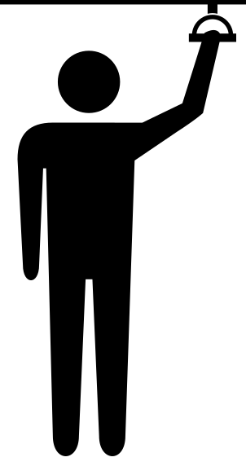




Lambeth’s strengths
The top three factors that residents feel make Lambeth a good place to live are unchanged from 2022 – public transport, parks, and the borough’s diverse and multicultural communities. The only significant change is a rise in the perceived importance of the borough’s education provision.
ARS 2022
Q. Thinking about living in Lambeth, what are the most important things that make Lambeth a good place to live? Base: all respondents in group B who identified a preference (888)

Slide 19
Area satisfaction
Lambeth residents’ satisfaction with their local area has continued to decline year-on-year. Although satisfaction is below the national benchmark, it is still above the London benchmark.
Inter-group differences
68%
are satisfied with their local area as a place to live
West Dulwich (89%), Waterloo and South Bank (89%), Gipsy Hill (88%), St Martin’s (47%) and Streatham Wells (50%) wards
Residents aged 18-24 (97%)
Residents who have a mean income of £30,000-£49,999 (63%) vs £50,000-£69,999 (74%)
Disabled (60%) vs non-disabled (72%)
Benchmark comparisons
ARS
2021
vs London benchmark
62% satisfied
vs national benchmark
75% satisfied
ARS
2021
+6
ARS
2023
-7
Q. Overall, how satisfied or dissatisfied are you with your local area as a place to live? Base: all respondents in group A (1,039).

Slide 20
Key drivers of area satisfaction
The most important driver of area satisfaction is whether residents feel their local area is a good place for children and young people to grow up. People who agree their area is ‘child-friendly’ in this way tend to be more satisfied with their area, while those who disagree tend to be less satisfied. Its relative importance score (0.23) indicates that it over three times more important as a driver compared to, for example, whether residents find the area safe during the day (ranked 5th,with a relative importance of 0.07).
Rank | Driver | Relative importance | Performance*
1 | Local area is a good place to grow up | 0.23 | 43% net positive
2 | Feelings of safety in the evening | 0.18 | 58% net safe
3 | Use health centres at least monthly | 0.17 | 25% at least monthly
4 | Agree that Lambeth Council provides value for money | 0.12 | 37% net good value
5 | Feelings of safety during the day | 0.07 | 88% net safe
6 | People being drunk or rowdy in public places NOT a problem | 0.07 | 58% net not problem
7 | Serious youth violence NOT a problem | 0.07 | 37% net not problem
8 | Use local restaurants and cafes at least monthly | 0.05 | 65% at least monthly
9 | Agree could go to someone in neighbourhood for advice | 0.05 | 41% net agree
10 | Lambeth Council...is NOT difficult to get through on the phone | 0.05 | 45% net agree
Key driver analysis is a statistical method that helps identify the factors that have the most impact on a particular outcome. In this case, we used it to understand what influences residents' satisfaction with their local area
After analyzing other questions in the survey, we found that 10 particularly played a role, to varying degrees, in shaping area satisfaction this year. Together, these 10 questions account for 70.1% of the variation in residents' satisfaction with their local area.
*Figures do not exclude DK responses as done elsewhere, and so may differ slightly from figures in other slides in this report.

Slide 21



Town centres
37% agree their town centre is attractive as a place to visit
Area differences
Waterloo 54%*
North Lambeth 37%
Stockwell 34%
Clapham 40%
Brixton 40%
ARS
2021
ARS
2022
ARS
2023
Streatham 25%
Norwood 37%
44% agree their town centre is welcoming as a place to visit
Area differences
Waterloo 48%*
North Lambeth 42%
Stockwell 44%
Clapham 50%
Brixton 37%
ARS
2021
ARS
2022
ARS
2023
Norwood 47%
Streatham 42%
Q. To what extent do you agree or disagree with the following statements about your local town centre as a place to visit? Base: all respondents in group B (972). *Caution: low base size (<30)

Slide 22


Housing
Satisfaction with various aspects of renting has continued to decline significantly. Compared to other renters, Council tenants are also less likely to be satisfied across most indicators – except when it comes to the value for money of their rent.
48%
of renters are satisfied with their landlord overall
42%
satisfied with the value for money of their rent
-9 from 2022
HA 49%, Council tenants 45%, private renters 37%
52%
satisfied with the general condition of the property
-4 from 2022
HA 50%, Council tenants 35%, private renters 62%
ARS
2021
ARS
2022
ARS
2023
satisfied with the way the landlord deals with repairs and maintenance
-8 from 2022
HA 37%, Council tenants 24%, private renters 55%
42%
Satisfaction by tenure
Rent from housing association (HA)
47% (-7 vs 2022)
Rent from Council
29% (-11 vs 2022)
Rent from private landlord
58% (-7 vs 2022)
42%
satisfied that their landlord listens to their views and acts on them
-5 from 2022
HA 33%, Council tenants 27%, private renters 55%
Q. Taking everything into account, how satisfied or dissatisfied are you with the overall service provided by your landlord? Base: all respondents living in rented accommodation (785).

Slide 23

Overall health
Two-thirds of residents believe they are in good health, but this is significantly poorer than in 2022 when 72% of residents indicated this. There are also a number of significant inter-group differences – particularly along more economic lines (such as income, tenure, and activity status).
ARS 2022
Inter-group differences (% good/very health)
66%
in overall good health
9%
in overall poor health
Mean paycheck equivalised annual income
Q. How is your health in general? Base: all respondents (2,011).

Slide 24


Mental health and wellbeing
Residents’ sense of life worth and anxiety have remained mostly stable since 2021, however there has been a significant decline in the proportion of residents who feel neutrally about their life worth. Younger and disabled people are significantly less likely to have a positive sense of life worth, and significantly more likely to have a high level of anxiety.
Overall, to what extent do you feel the things you do in your life are worthwhile?
How anxious did you feel yesterday?
7.9
average life worth score
4.1
average anxiety score
Differences (% positive)
Differences (% negative)
18-24s (20%)
65+s (45%)
Female (41%) vs male (33%)
Black residents (50%) vs White British (33%)
Heterosexual (39%) vs LGB (31%)
Disabled (32%) vs non-disabled (39%)
Disabled (50%) vs non-disabled (29%)
Economically active (32%) vs inactive (39%)
18-24s (59%)
Residents in less deprived areas (IMD-4, 45%)
Residents with care experience (48%) vs without (33%)
Q. Overall, to what extent do you feel the things you do in your life are worthwhile? Base: all respondents (2,011)
Q. Overall, how anxious did you feel yesterday? Base: all respondents (2,011).

Slide 25







The environment and climate change
A significant majority of residents are worried about the future of the environment and agree that tackling climate change is important to them.
‘It’s important to me to be environmentally friendly to help combat climate change.’
Importance
18-24s significantly more likely to agree (93%) vs 65+s (80%)
‘I am worried about the future of the environment.’
‘I understand the potential impact of climate change to me / my area.’
‘I understand what I can do…to protect me from the impacts of climate change.’
‘I have walked and/or cycled more over the last 12 months.’
Seriousness
Social renters significantly more likely to agree it is exaggerated (32%) vs owner-occupiers (12%).
‘The seriousness of climate change is exaggerated.’
Q. To what extent do you agree or disagree with the following statements? Base: all respondents (2,011)

Slide 26

Making Lambeth one of the safest boroughs in London

Slide 27


Feelings of safety
Feelings of safety both during the day and at night have declined significantly since 2022, however both are still well above the London benchmark. Women and residents in Streatham are significantly less likely to feel save in the evening.
Deep dive: feeling safe in the evening
% feeling safe during the day
Sexual orientation
Area differences
London benchmark
Waterloo 65%*
North Lambeth 57%
% feeling safe in the evening
Gender
Stockwell 55%
London
benchmark
Clapham 60%
Brixton 54%
Ethnicity
Norwood 65%
Streatham 47%
Q. To what extent would you say you are, or would be, safe from crime when walking in your local area…? Base: all respondents in group A (1,039).

Slide 28
Anti-social behaviours
As in 2022, the amount of rubbish or litter is the most widely identified problem among Lambeth residents – it has also been considered a problem by significantly more residents year on year. There has also been a significant increase in concern about drug abuse and serious youth violence.
% problem
Inter-group differences
68% (+3)
59% (+4)
59% (+3)
57% (+4)
53% (+2)
49% (+2)
Rubbish or litter
Residents in Waterloo are significantly less likely to see this as a very big problem (16%)
Using or doing drugs
Residents in Brixton are significantly more likely to see this as a very big problem (42%), while residents in Norwood are less likely (22%).
Serious youth violence
Residents in Brixton (37% ‘a very big problem’)
65+s (10%)
Female (28%) vs male residents (24%)
Economically active (27%) vs inactive (22%)
Disabled (31%) vs non-disabled (25%)
Most deprived areas (IMD-1, 36%) vs less deprived (IMD-4, 15%)
Q. Thinking about this local area, how much of a problem do you think each of the following are…? Base: all respondents excluding don’t know (bases vary).

Slide 29




Harassment, hate crime, and confidence
In the past 12 months…
1 in 4 residents (24%)
have experienced sexual harassment or a hate crime
+4 from 2022
of residents who experienced a sexual harassment and/or hate crime reported the incident to someone
+5 from 2022
52%
1 in 5 women (19%)
have experienced sexual harassment
compared to 3% of men
 | The police | Another org. | A friend / relative | Did not report
Racist hate crime | 17% | 11% | 27% | 45%
Homophobic hate crime | 21% | 9% | 31% | 47%
Faith hate crime | 26% | 11% | 33% | 26%
Disability hate crime | 0% | 25% | 18% | 53%
Sexual harassment | 14% | 7% | 35% | 47%
1 in 6 residents (16%)
have experienced a hate crime
+5 from 2022
Racist hate crimes
Experienced by 18% of Asian residents and 15% of Black residents, compared to 5% of White British residents.
Homophobic hate crimes
34% of LGB residents (+13 compared to 21% in 2022)
Disablist hate crimes
Experienced by 8% of disabled residents (compared to 5% in 2022)
of residents agree they have confidence in their local police
-1 from 2022
LGB residents are significantly less likely to have confidence (26%). 65+s significantly more likely (45%).
33%
Q. Have you personally experienced sexual harassment or any of the following types of hate crime in Lambeth over the last 12 months? Base: all respondents (2,011)
Q. Did you report the incident to any of the following? Base: all respondents who experienced a hate crime or sexual harassment (411). Don’t know / PNTS figures not displayed.
Q. To what extent do you agree or disagree that you have confidence in the police in your local area? Base: all respondents (2,011).

Slide 30

Recommendations and next steps

Slide 31

Key drivers for action
Based on our analysis of the drivers behind Council and area satisfaction (see p.7 and p.20), the ten most important factors behind each of these can be prioritised according to how well the Council is performing on them in this year’s Annual Residents’ Survey, and how relatively important they are in terms of predicting how satisfied a resident is. Factors with both lower performance and higher importance point to the actions most likely to boost satisfaction:
Tackle rubbish and litter
Help residents feel more able to influence decisions
Grow our reputation as an authority that resolves things quickly
Improving residents’ sense of the value for money of council tax
Making Lambeth a better place to grow up / more child-friendly
Improving access to healthcare
Higher performance, lower importance Hidden drivers: MAINTAIN | Higher performance, higher importance Visible drivers: PROMOTE
Lower performance, lower importance Weak drivers: MONITOR | Lower performance, higher importance Key drivers: ACT
Drivers: Satisfaction with the Council (44%)
Drivers: Satisfaction with local area (68%)
Maintain
Promote
Maintain
Promote
Monitor
Act
Monitor
Act

Slide 32

Sample profile and demographics

Slide 33
Number of responses by ward

Slide 34
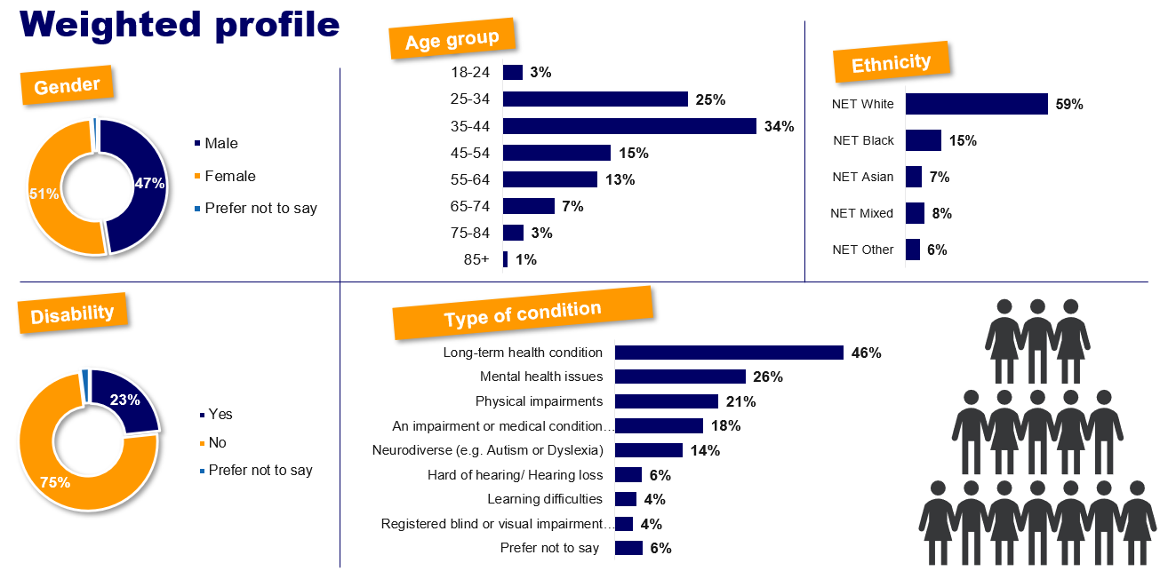
Weighted profile

Slide 35
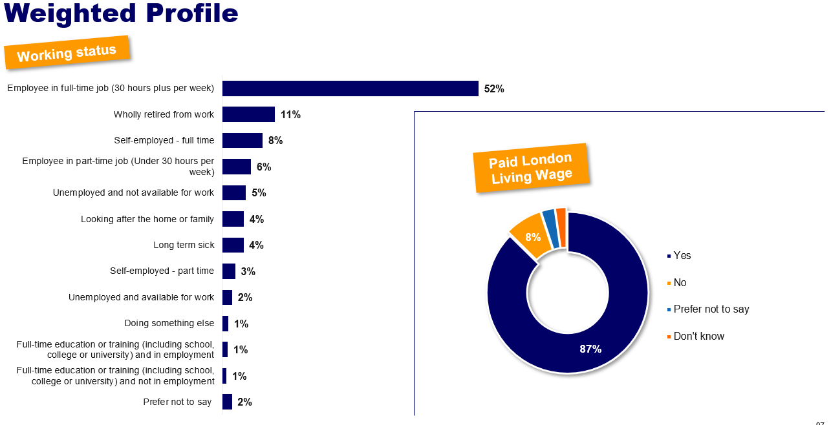
Weighted profile (cont’d)

Slide 36
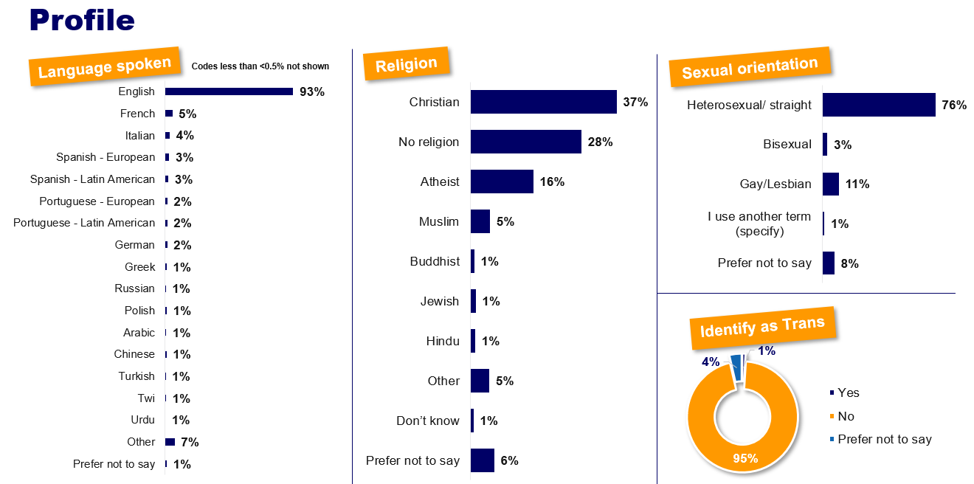
Weighted profile (cont’d)

